Slide 1


Distributed training &
RDMA (Advanced topic)
SE3331-1 (2025 Fall)
Xingda Wei, Yubin Xia
IPADS, Shanghai Jiao Tong University
https://www.sjtu.edu.cn
Credits: AI-sys Sp22, CMU15-418

Slide 2
Review: The computation graph abstraction
Computations are expressed as a graph (Directly acrylic graph)
  Vertices are computations (or data)
  Edges are communication channels
  Each vertex has several input and output edges
Outputs
Processing
Vertices
Channels
(file, pipe, memory)
Inputs

Slide 3
Case study: Distributed training

Slide 4
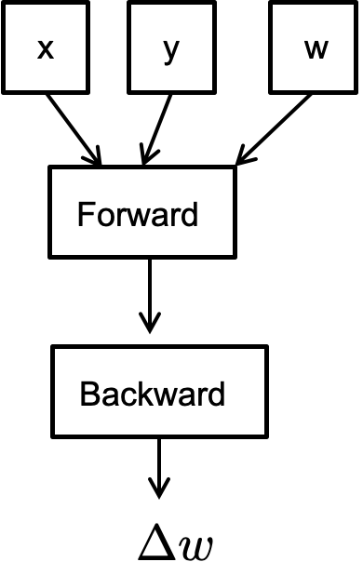
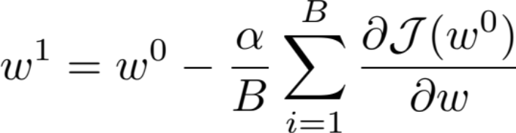
Pseudocode for Stochastic Gradient Descent
// execute on a master
for iter in num_iters:
iter
iter+1
iter
Problem: the graph cannot be parallelized across different nodes!

Slide 5
Review: Parallelization Opportunities
Data Parallelism: Distribute the processing of data to multiple PEs.
Model Parallelism: Break the model and distribute processing of every layer to multiple PEs
For either approach it is also possible to use synchronous or asynchronous updates

Slide 6
(Sync) data parallel

Slide 7
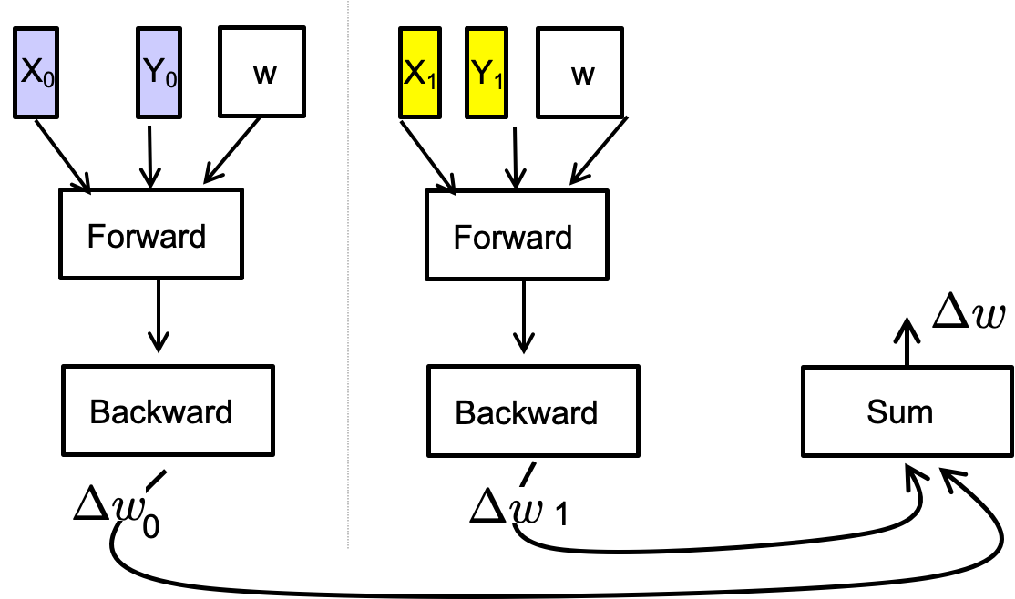
Pseudocode for (iterative) data parallel in action
// high-level code
for iter in num_iters:
iter
iter+1
iter

Slide 8

Design goal: high GPU utilization (MFU)
Model FLOPs Utilization
Depends on several factors
  Whether the forward + backward can fully utilize the GPUs? (See the last lecture)
  Can we hide the GPU idle time? Yes, via overlapping
  Optimize the synchronization part
Sum
0
Forward + backward
1

Slide 9
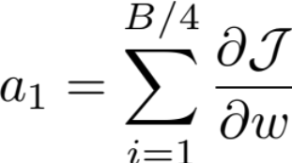
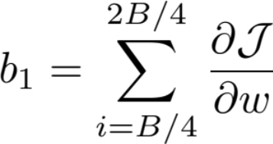
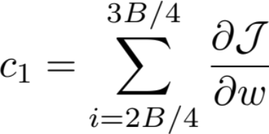
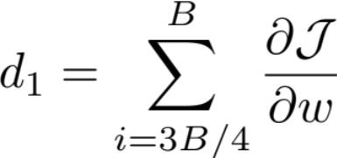
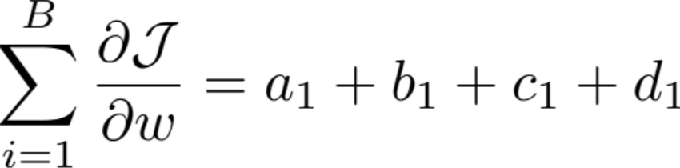
Key operator: allreduce
GPU 1
GPU 2
GPU 3
GPU 4
ALLREDUCE

Slide 10
Review: parameter server
Each process pushes the data to the parameter server (PS)
After receiving all data, aggregate the data at the PS
3. The PS pushes the data back to the processes
+
=
PS
0
1
Step #1
Step #2
Step #3

Slide 11
Review: Co-located & sharded PS
The PS is collocated on all the servers
Each server handles the reduce of a portion of data
0
0
0
1
2
0
0
1
0
1
2
0
0
2
0
1
2
Benefit: the inbound bandwidth requirement is reduced by #P

Slide 12
Review: Decentralized approach w/ only peer connections
Peer connections: GPU 1 only connects to GPU 0 and 2 (its neighbors)
  Question: do the send of GPU to GPU2 needs coordination?
0 1 2 3
0
1
2
3
12

Slide 13
Try #3: Ring allreduce
Decentralized reduce, each process reduce on a partitioned data (prev/next to it)
  i.e., each process send one partition, compute it, & then sends to the next process
0 1 2 3
0
1
0
2
1
3
2
1
2
3
0
2
3
0
1
3
13

Slide 14
Ring allreduce
After the individual reduce, each process can scatter to collect results
  Eventually, all the processes will have the same reduced data
Question: different partition has a different reduce order, does it ok?
0
1
2
3

Slide 15
Why ring allreduce can work?
Assumption: reduce op is associative & communicative
  So we can reorder them to reduce sudden loads at a node
  E.g., we don’t need to collect all the data to do the reduce
Otherwise, we cannot reorder the computation

Slide 16
Analysis of the communication cost of ring allreduce
N: total parameters, P: # processors
Total communication per-machine
  2 * (P-1) * N / P: the same as partitioned
  O(1) fan-in
Total communication rounds: O(P)
  Much higher than the parameter server approach (O(1))
  A trade-off for reducing network contention due to high fan-in
What are the drawback?
  High latency due to extra rounds

Slide 17
Allreduce: put it all together
Trade-off between rounds vs. fan-in performance
  P: # processors/machines/GPUs participated in the computation
  N: the size of the data to be reduced
 | Round | Peak node bandwidth | Per-node fan-in
Parameter server (PS) | O(1) | O(N * P) | O(P)
Co-located & sharded PS | O(1) | O(N/P) | O(P)
Decentralized Allreduce | O(P) | O(N) | O(1)
Ring allreduce | O(2 * P) | O(N/P) | O(1)

Slide 18
More reduce method: Double Binary Tree All-Reduce
Two overlaid binary reduction trees
Double the fan-in → Log(p) rounds of communication
  Currently used on the NCCL
https://devblogs.nvidia.com/massively-scale-deep-learning-training-nccl-2-4/

Slide 19
More reduce methods exist
Key design goals
  Reduce payload sent per-node
  Reduce fan-in to avoid contention on network resource
  Reduce rounds (grow linearly w/ the number of processors)
  (new) Better suits the underlying hardware (Cloud & HPC)
  (new) In-network computing (e.g., NVIDIA SHARP)
Still an active research field
  E.g., what if the hardware speed between different machines diff?
  What if the link speed changes overtime?

Slide 20
Case study: NVLink + RDMA
Setup
  Each machine has multiple GPUs for computation
  These GPUs essentially form a distributed (processing) system
NVLink
  Fast interconnects that connect different GPUs
RDMA (Described later)
  Fast networking feature that connects different machines

Slide 21

What does NVLink Look Like?
8-GPU on single board

Slide 22
Communication heterogeneity
Different nodes’ link capacity differs
  Internode: high bandwidth (e.g., 450GBps)
  Intranode: relative slow bandwidth (e.g., 100GBps)
Optimization opportunities
  We can do a parameter server within a server, and do rings across servers
  We will see more examples later
Server
GPU 0
GPU 2
GPU 0
GPU 2
NVLink
RDMA
NVLink
GPU 1
GPU 3
GPU 1
GPU 3

Slide 23
Parallelization Opportunities
Data Parallelism: Distribute the processing of data to multiple PEs.
Model Parallelism: Break the model and distribute processing of every layer to multiple PEs
For either approach it is also possible to use synchronous or asynchronous updates

Slide 24

Recall: Data Parallelism
X₀
Y₀
w
X₁
Y₁
w
Question: What is the assumption of W?
Forward
Forward
Backward
Backward
Sum
0
1

Slide 25
Drawback of data parallelism: replicated model
Data parallelism assumes the model (parameters) are replicated on all the processes
  Such that they can do the forward & backward pass dependently
  What if the model cannot fit onto the device?
Current trends: models are becoming larger and larger
  No country (or company) can tolerate the risk of falling behind in the AI race

Slide 26
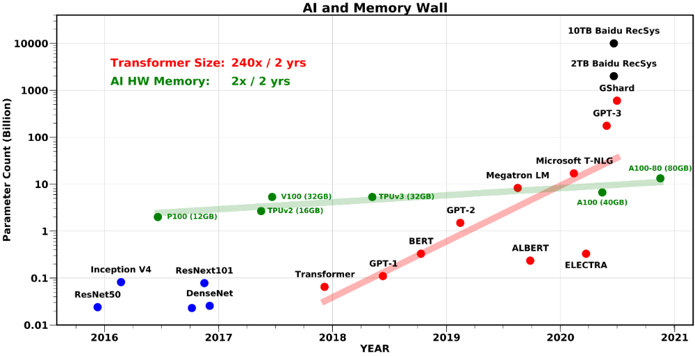
Trend: Training Large Models
Beyond single chip memory
Amir Gholami, Zhewei Yao, Sehoon Kim, Michael W. Mahoney, Kurt Keutzer, AI and Memory Wall, Riselab Medium Blogpost, 2021.

Slide 27
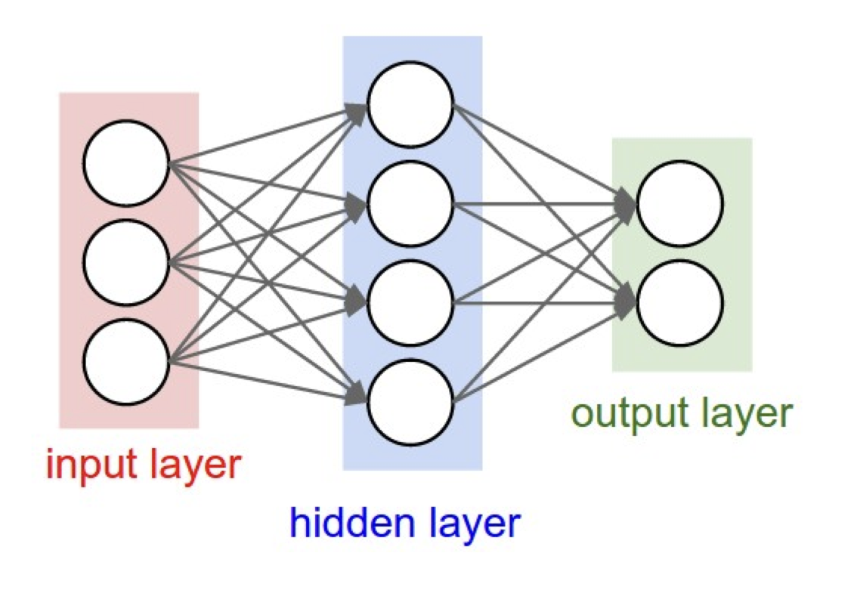
Model parallelism
Partition the parameters of a model, typically done in two ways:
  Partition on the layer: pipeline parallelism
  Partition on the W: tensor parallelism
X
Y
w
W1
W2
Forward

Slide 28

Pipeline parallelism
Partition the computation layer-by-layer, each partition is deployed on a device
  Note that different layers can be grouped together
  The strategy is out of the scope of this course
X
Y
w1
Layer #1
w2
Layer #2
The partitioned computation graph
The model

Slide 29
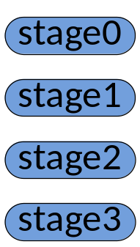

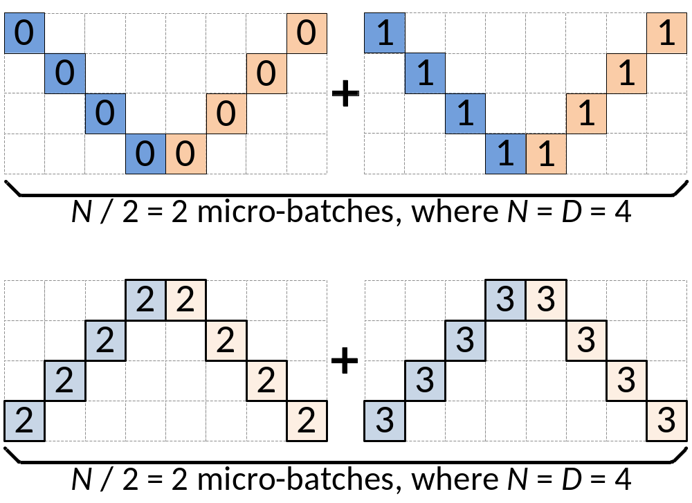






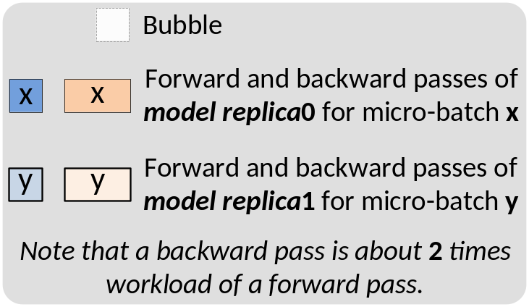
Pipeline parallelism
Bubble where processes are idle
Time
Note that each stage may contain multiple layers, where the detailed number is configurable
How to reduce bubble?

Slide 30
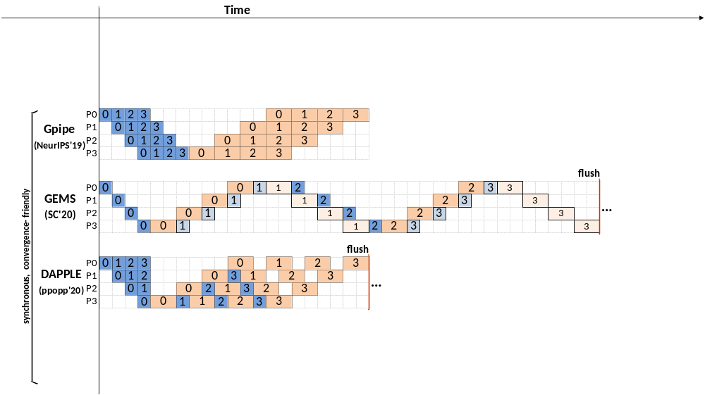
Technique: micro-batching
Reducing the bubble size by breaking the batch size into smaller pieces to reduce the idle time of the processes
  Reduces bubble size in an easy way to implement
Question: to what extent can micro-batching improves performance?
  The bubble size depends on the #partitions (p)
  The ratio bubble overhead depends on the overall pipeline numbers (m)
m
p

Slide 31
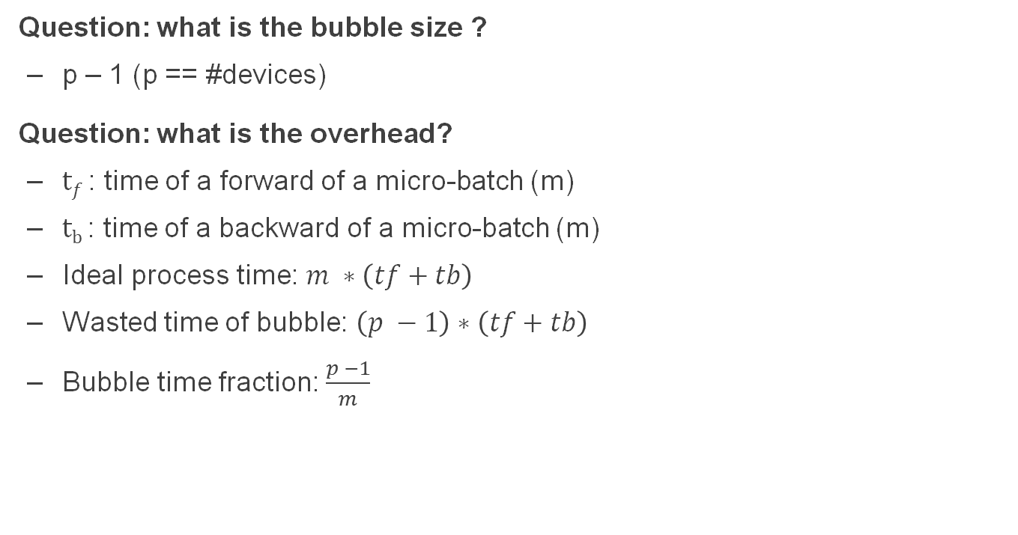
Pipeline parallelism & the number of micro-batch
Question: what is the bubble size ?
  p – 1 (p == #devices)
Question: what is the overhead?
  $tf$ : time of a forward of a micro-batch (m)
  $tb$ : time of a backward of a micro-batch (m)
  Ideal process time: $m ∗\left(tf+tb\right)$
  Wasted time of bubble: $\left(p −1\right)∗\left(tf+tb\right)$
  Bubble time fraction: $\frac{p −1}{m}$

Slide 32
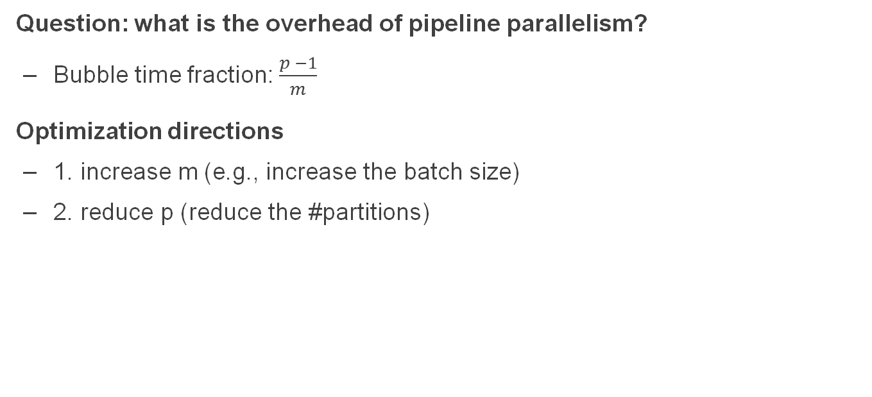
Pipeline parallelism & the number of micro-batch
Question: what is the overhead of pipeline parallelism?
  Bubble time fraction: $\frac{p −1}{m}$
Optimization directions
  1. increase m (e.g., increase the batch size)
  2. reduce p (reduce the #partitions)

Slide 33
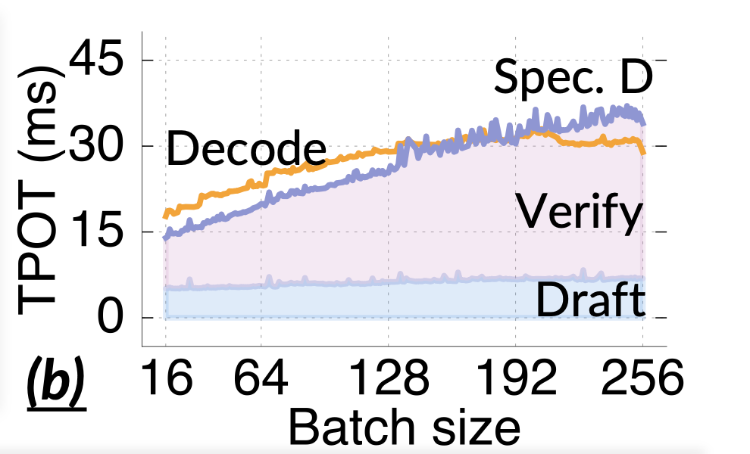
Why increase M requires increasing the batch size?
A too small batch size is inefficient in GPU utilization
  Intuitively, the W is reused across each request
  Thus, increase batch size by 2X would lead to only < 2X increased execution time
d_{i}
B
P₀
P₀
P₁
*
d_{i}
P₁
W
X
  Case study: LLM inference performance (see Fast LLM Post-training via Decoupled and Fastest-of-N Speculation)

Slide 34
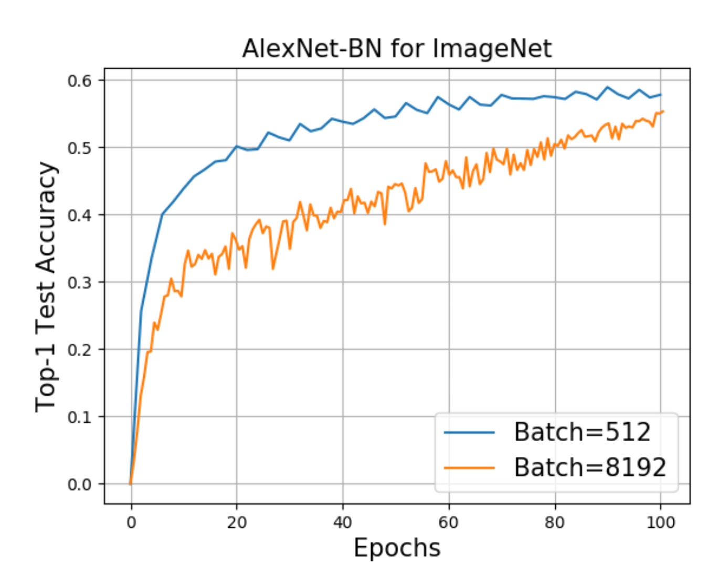
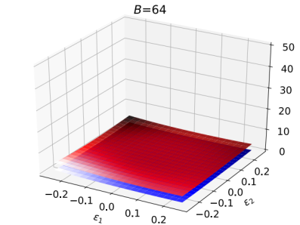
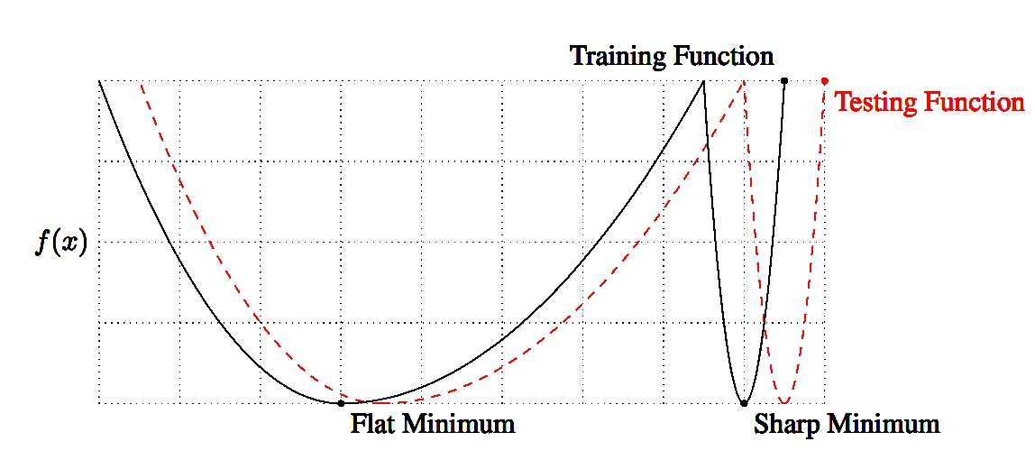
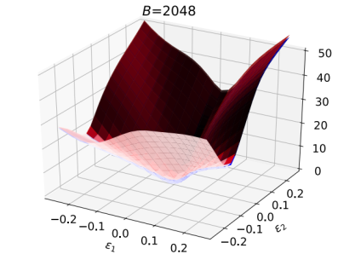
Problems with Large Batch Training
Larger Batch leads to sub-optimal generalization
A common belief is that large batch training gets attracted to “sharp minimas”
Key takeaway: improving system should consider application properties
Keskar et al., On Large-Batch Training for Deep Learning: Generalization Gap and Sharp Minima, ICLR’16.
Z. Yao, A. Gholami, Q. Lei, K. Keutzer, M. Mahoney. Hessian-based Analysis of Large Batch Training and Robustness to Adversaries, NeurIPS’18.
Ginsburg, Boris, Igor Gitman, and Yang You. "Large Batch Training of Convolutional Networks with LARS." arXiv:1708.03888, 2018.

Slide 35
Problems with large batch size
P#0. (Possible) Decreased accuracy
P#1. Increased memory at each device
  Memory used for storing the activation memory
Though some optimizations exist
  E.g., Re-computation, throw away the intermedia activations generated during the forward path, re-compute it during the backward path
  Cons: trades performance for memory usage

Slide 36
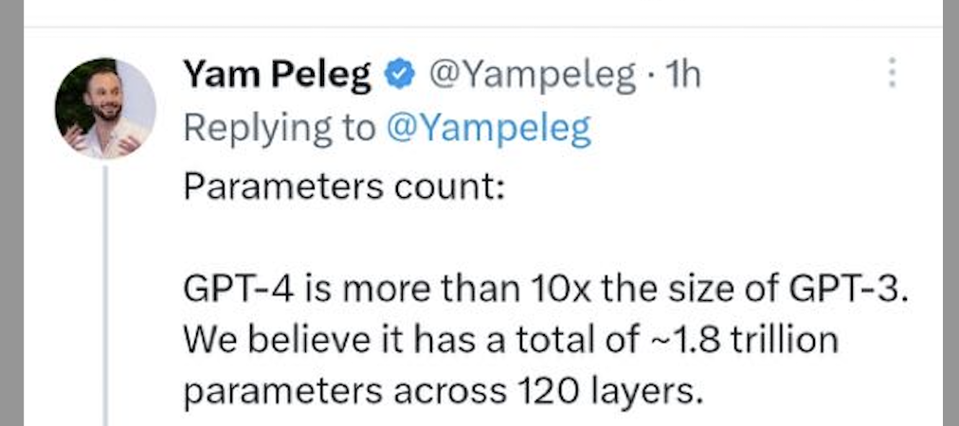
Can we reduce the number of pipeline stages (p)?
Typically, also challenging because AI models are really really large
Example: GPT-4
  Setup: 1.8 trillion parameters
  120 layers
  Assuming 4B for each parameter, we have 60 GB per-layer
What are the memory capacity of GPU?
  80 GB for H100, 140 GB for H200
  Note that we also need to store activations & input data ( & optimization state)

Slide 37
Tensor parallelism (TP)
X
Y
w1
Partition the parameters of a layer
  Each partition is deployed on a separate GPU
A group of GPUs hosting a complete set of W is treated as a large logical GPU to simplify the analysis
Layer #1
w2
Layer #2

Slide 38
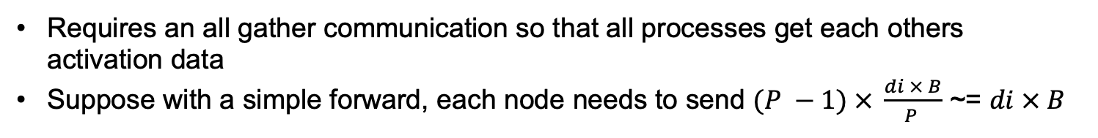
Model Parallelism (use matrix multiplication as an example): Forward Pass
d_{i}
B
B
P₀
P₀
P₁
P₀
P₀
P₁
d_{i}/P
d_{i}/P
*
d_{i}
P₁
P₁
W
X
Y^{local}
Y
Requires an all gather communication so that all processes get each others activation data
Suppose with a simple forward, each node needs to send $(P −1) × \frac{di × B}{P }$ ~= $di × B$
Notes:
\begin{align*}
\sum_{i=1}^{L} \beta (P-1) \frac{Bd_i}{P}\right)
\end{align*}
\begin{align*}
T_{{comm}}({domain}) = &\sum_{i=1}^{L}\left(\alpha {\log(P)}+ \beta \frac{P-1}{P} Bd_i\right)\\
+2&\sum_{i=2}^{L}\left(\alpha {\log(P)}+ \beta \frac{P-1}{P} d_{i-1}\right)
\end{align*}

Slide 39
Model Parallelism: Backward Pass
P₀
P_{0,} P₁
P₀
d_{i}/P
*
P₁
P₁
X^{T}
∇_{Y}
∇_{W}
No communication needed as every processor only needs the gradient of its own parameters
Notes:
\begin{align*}
\sum_{i=1}^{L} \beta (P-1) \frac{Bd_i}{P}\right)
\end{align*}
\begin{align*}
T_{{comm}}({domain}) = &\sum_{i=1}^{L}\left(\alpha {\log(P)}+ \beta \frac{P-1}{P} Bd_i\right)\\
+2&\sum_{i=2}^{L}\left(\alpha {\log(P)}+ \beta \frac{P-1}{P} d_{i-1}\right)
\end{align*}

Slide 40
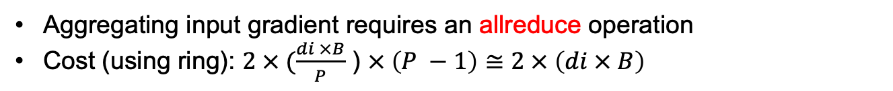
Backward Pass
P₀
d_{i}/P
B
P₀
P₁
P₀
P₁
P₀
P₁
d_{i}
*
d_{i}
P₁
W^{T}
∇_{Y}
∇_{X}
∇_{X} ^{local}
Aggregating input gradient requires an allreduce operation
Cost (using ring): $2 × (\frac{di ×B}{P}$ ) $× \left(P −1\right)≅2 × \left(di × B\right)$
Notes:
\begin{align*}
2\sum_{i=2}^{L}\left(\beta (P-1) \frac{Bd_i}{P}\right)
\end{align*}

Slide 41
The cost of model parallelism
Networking cost during model parallelism
The network communication time
0
0

Slide 42
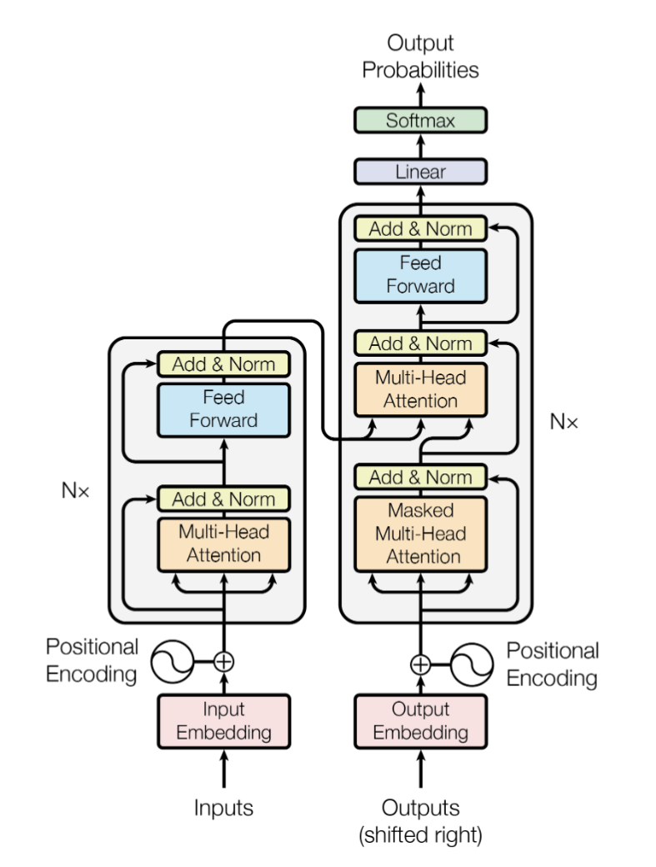
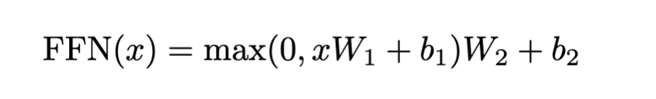
Analysis of the network cost of model parallelism
Pipeline parallelism
One layer (deployed on 2 GPUs w/ Tensor parallelism)
One layer (deployed on 2 GPUs w/ Tensor parallelism)
  See: Attention is all you need

Slide 43
Analysis of the network cost of model parallelism
d_{i}
B
B
P₀
P₀
P₁
P₀
P₀
P₁
P₀
P₁
d_{i}/P
d_{i}/P
*
d_{i}
P₁
P₁
W1
X
Y^{local}
Y
Y’
[Y] = max(0, Y)

Slide 44
Analysis of the network cost of model parallelism
d_{i}
B
B
P₀
P₀
P₁
P₀
P₀
P₁
d_{i}/P
d_{i}/P
*
d_{i}
P₁
P₁
W2
Y’
Z^{local}
Z

Slide 45
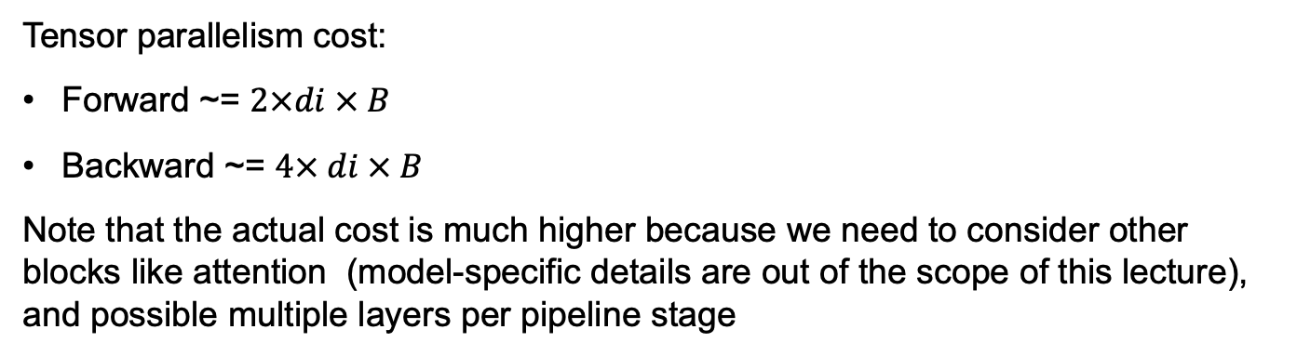
Analysis of the network cost of model parallelism
Pipeline parallelism
Z
One layer (deployed on 2 GPUs w/ Tensor parallelism)
One layer (deployed on 2 GPUs w/ Tensor parallelism)
Tensor parallelism cost:
Forward ~= $2×di × B$
Backward ~= $4× di × B$
Note that the actual cost is much higher because we need to consider other blocks like attention (model-specific details are out of the scope of this lecture), and possible multiple layers per pipeline stage

Slide 46
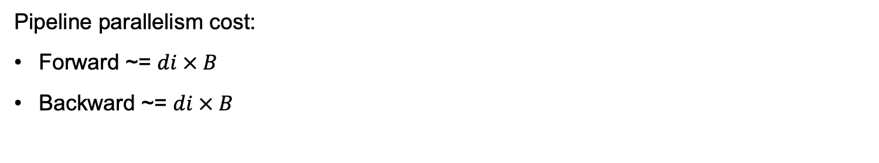
Analysis of the network cost of model parallelism
Pipeline parallelism
Z
One layer (deployed on 2 GPUs w/ Tensor parallelism)
One layer (deployed on 2 GPUs w/ Tensor parallelism)
Pipeline parallelism cost:
Forward ~= $di × B$
Backward ~= $di × B$

Slide 47
Review: Communication heterogeneity
Different nodes’ link capacity differs
  Internode: high bandwidth (e.g., 450GBps)
  Intranode: relative slow bandwidth (e.g., 100GBps)
Optimization opportunities
  We can do a parameter server within a server, and do rings across servers
Server
Layers with TP
GPU 0
GPU 2
GPU 0
GPU 2
NVLink
RDMA
NVLink
GPU 1
GPU 3
GPU 1
GPU 3

Slide 48
Review: Communication heterogeneity
Different nodes’ link capacity differs
  Internode: high bandwidth (e.g., 450GBps)
  Intranode: relative slow bandwidth (e.g., 100GBps)
Optimization opportunities
  We can do a parameter server within a server, and do rings across servers
Server
Layers with TP
A layer with TP
GPU 0
GPU 2
PP
GPU 0
GPU 2
NVLink
RDMA
NVLink
GPU 1
GPU 3
GPU 1
GPU 3

Slide 49

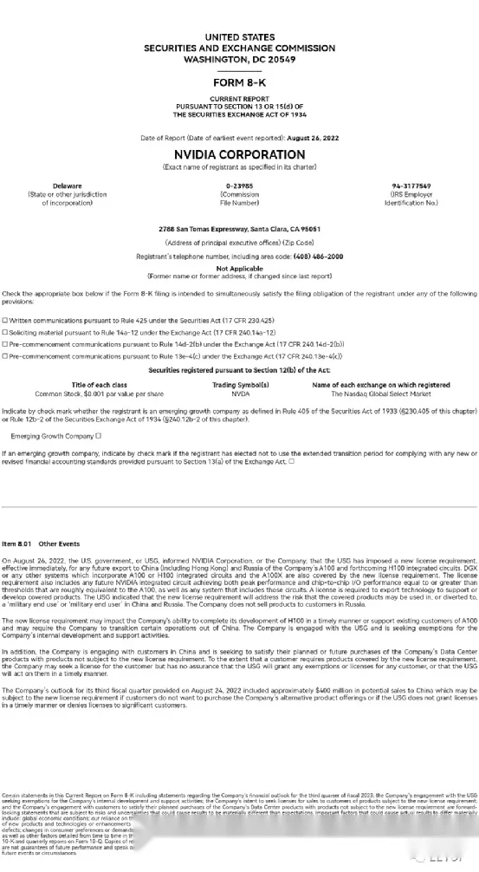
The US conducted a GPU ban on China, mainly restricting GPU communication performance

Slide 50
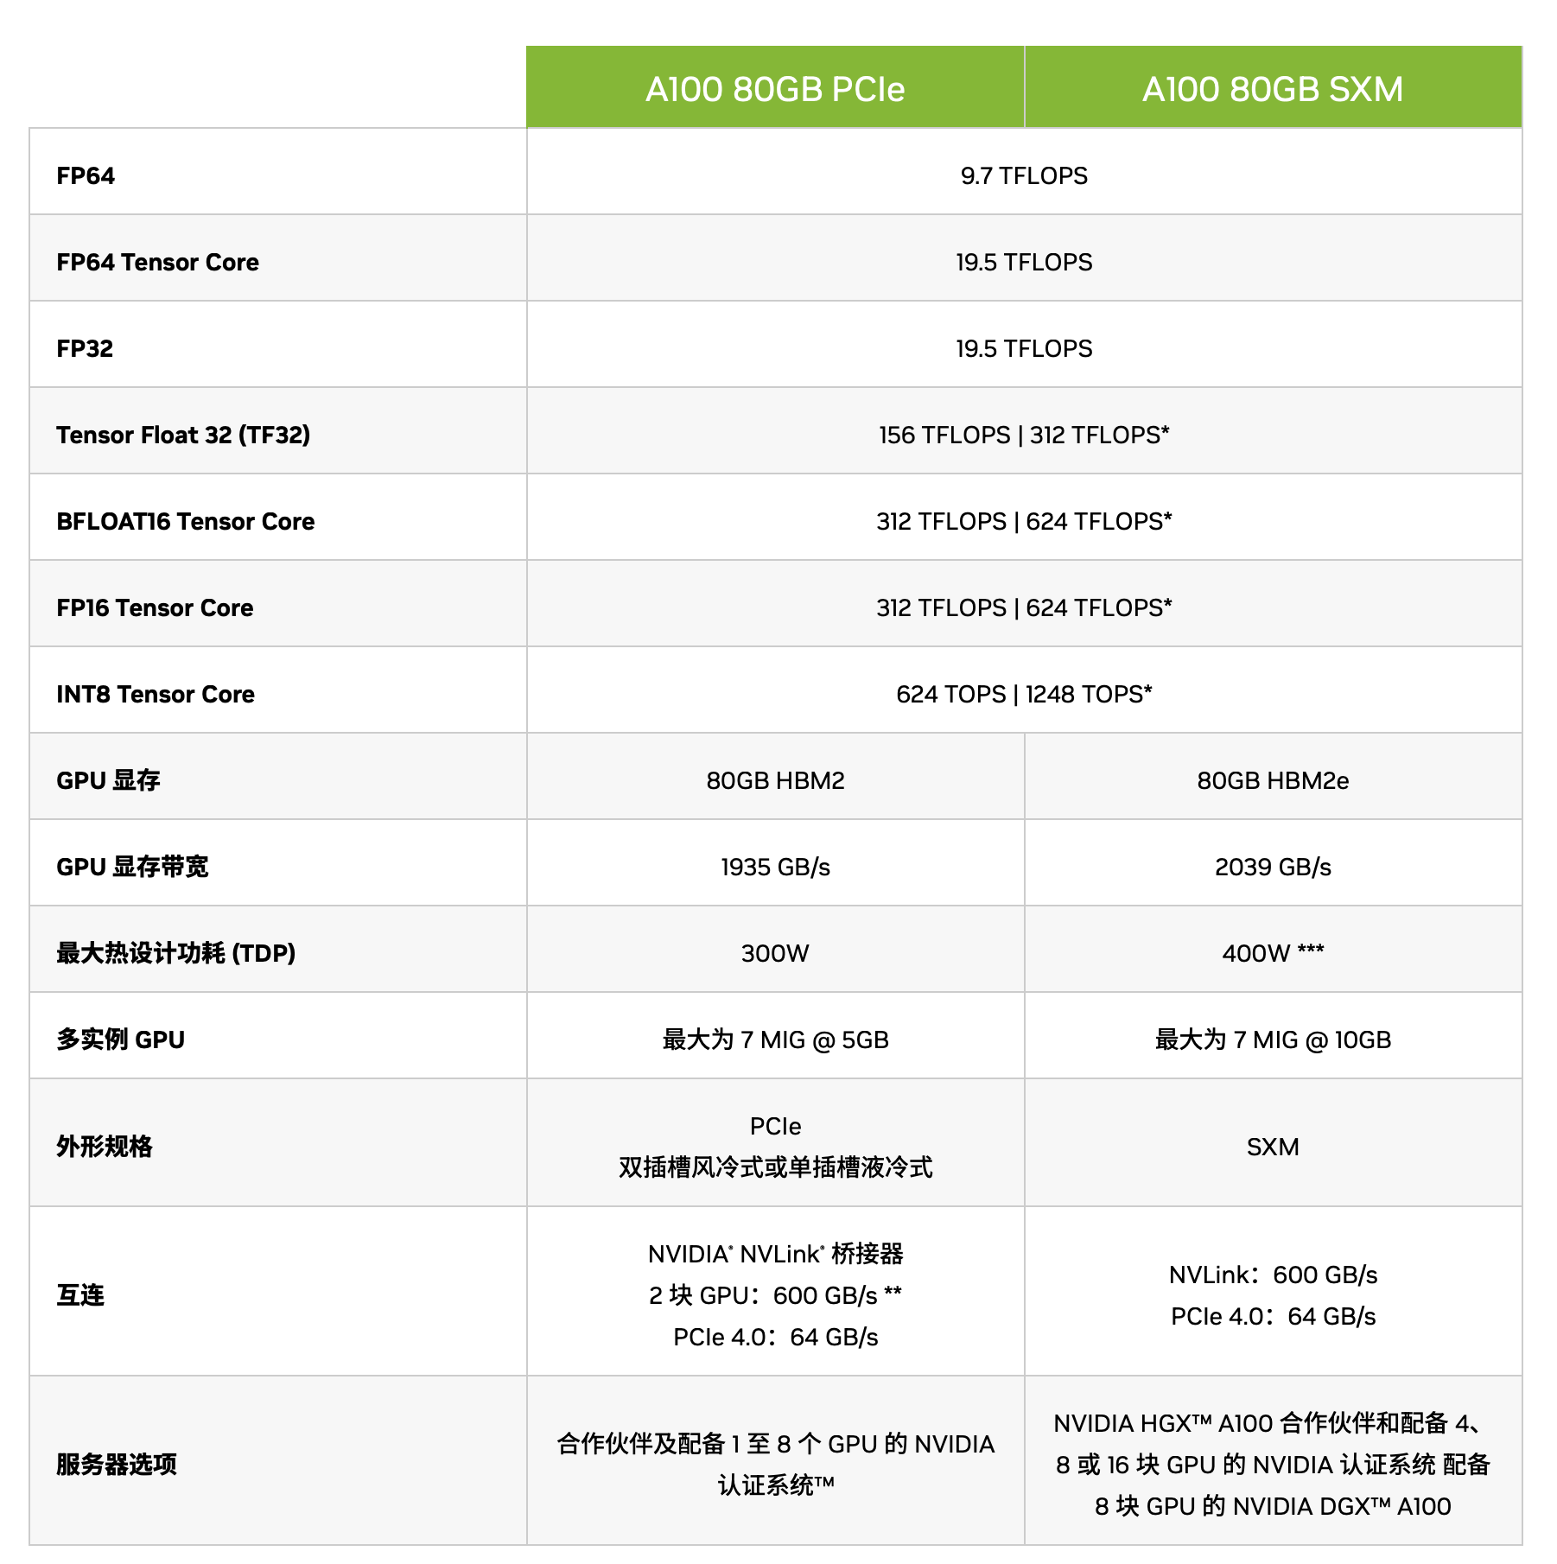
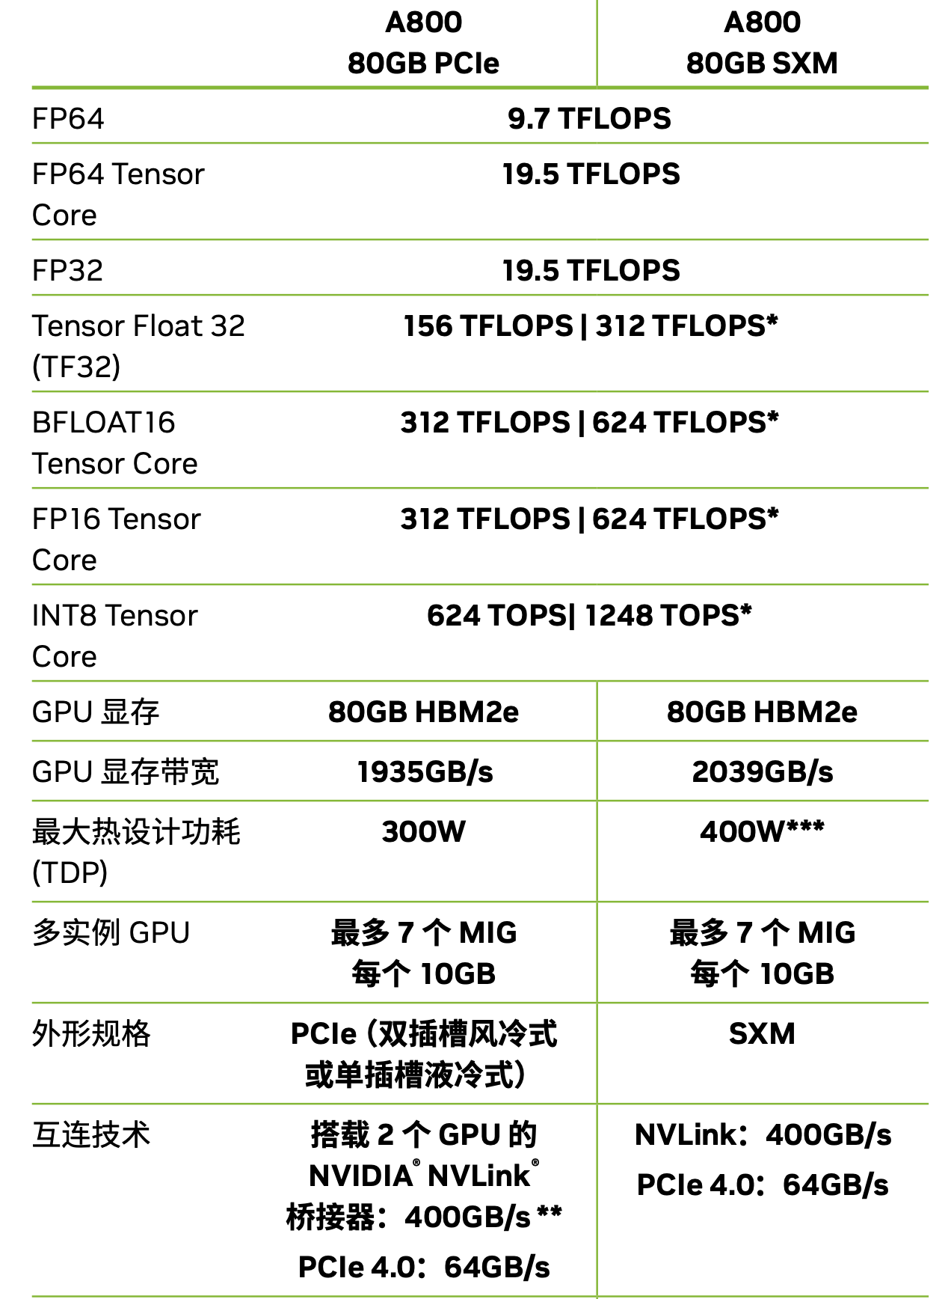
Case study: A100 vs. A800
Notes:
* 采用稀疏技术

Slide 51
Summary: model parallelism
Two forms: pipeline parallelism + tensor parallelism
Pipeline parallelism
  Partition the computation graph by layers
  Pros: reduced communication
  Cons: bubbles
Tensor parallelism
  Partition the parameters of a layer (or a set of layers )
  Pros: better support for large models
  Cons: high communication cost
Key system design principles: algorithm-hardware-aware co-design

Slide 52
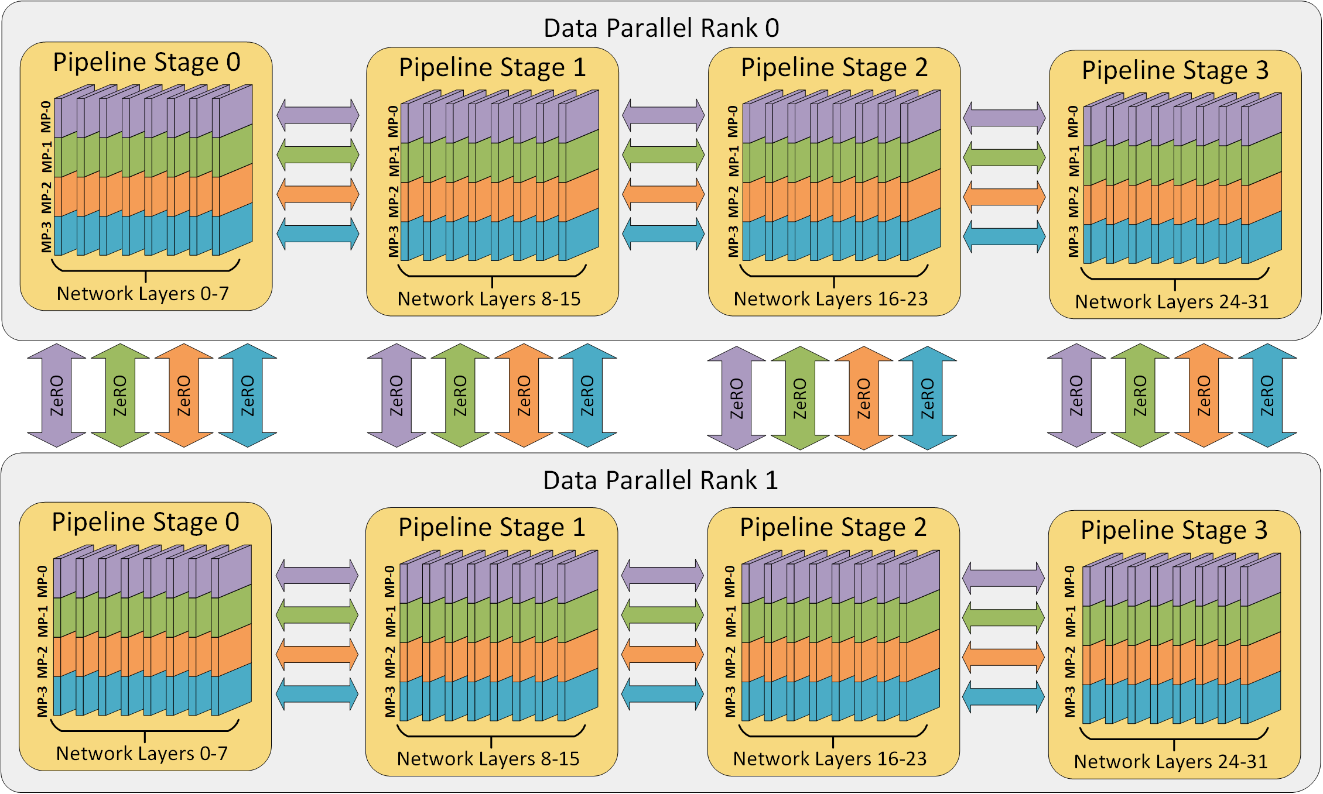
Put it altogether: parallelize distributed training

Slide 53
Parallelization Opportunities
Data Parallelism: Distribute the processing of data to multiple PEs.
Model Parallelism: Break the model and distribute processing of every layer to multiple PEs
For either approach it is also possible to use synchronous or asynchronous updates

Slide 54
Recall: data parallel execution
Problem: may have idle time at each process due to stragglers
Compute
Communicate
Compute
Machine 1
Iteration
Waste
Iteration
w
w¹
w
Machine 2
Iteration
Iteration
Waste
w
w²
w
Machine 3
Iteration
Waste
Iteration
Allreduce
w
w³
w
Barrier
Barrier

Slide 55
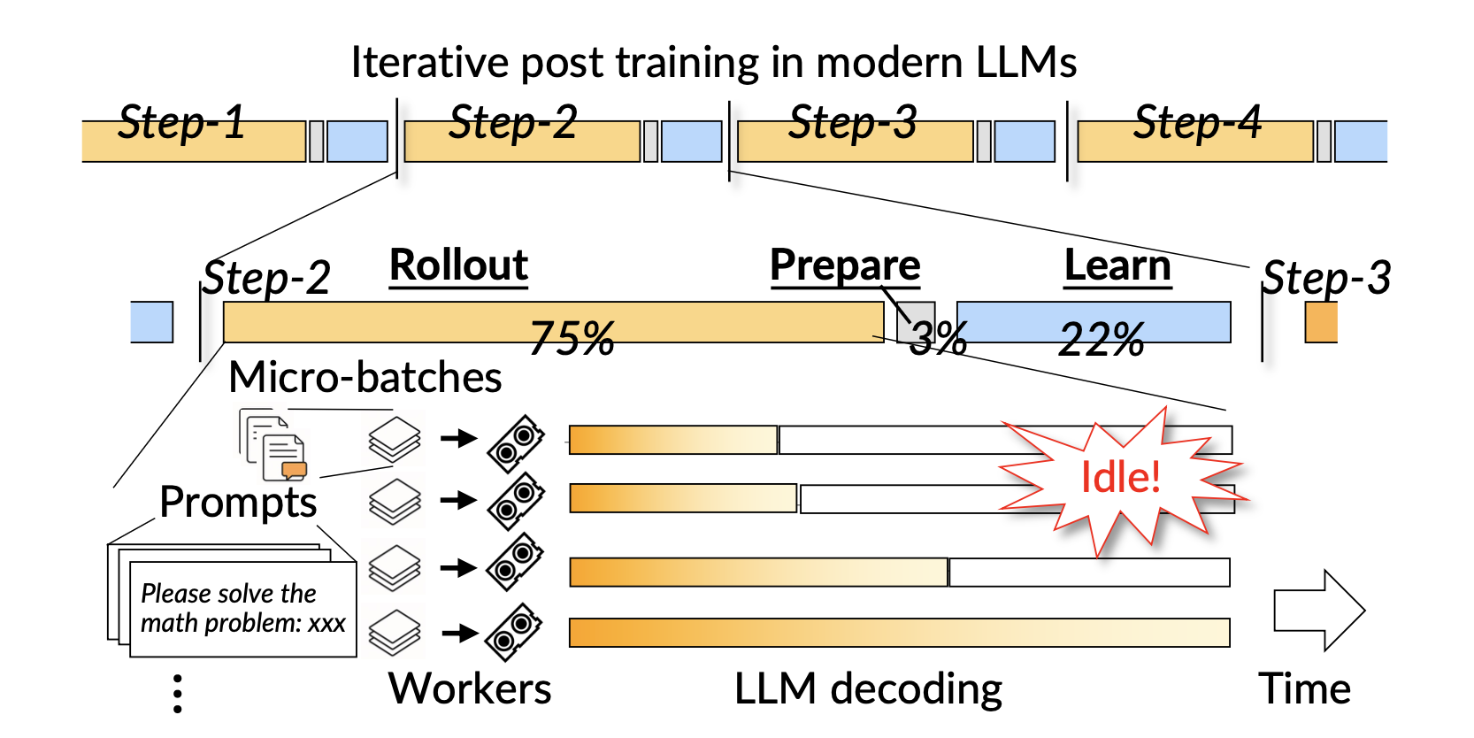
Straggler is also common, e.g., in LLM post-training
  Source: LLM inference performance (see Fast LLM Post-training via Decoupled and Fastest-of-N Speculation)

Slide 56
Asynchronous Execution
Key idea: each process does not wait for others
  Update the gradients upon receive a messages, no iteration barrier
Compute
Communicate
Compute
Machine 1
Iteration
Iteration
Machine 2
Iteration
Iteration
Machine 3
Iteration
Iteration

Slide 57
Async vs. Sync execution
Common: nearly all (pre) training currently adopts a synchronous approach
Async
  Pros: efficiency
  Cons: trade accuracy for performance
Sync
  Pros: Preserve the SGD training property
  Cons: poor performance
Which is better?
  Hard to tell. But, as a system designer, preserving the algorithms property is very important. Any design that alter the training property should be justified

Slide 58
Advanced topic: RDMA
Fast networking powering modern datacenter applications

Slide 59
Networking is a key component in distributed systems
Example: large-scale websites
  How each component communicates? Networking!
Caching server
Caching server
Caching server
…
Caching
Caching
Caching
Distributed caching
Database server
Database server
CDN
Users
Application #1
generate the page
Database
user, price
…
Database
user, price
Application server
Distributed database
Internet
Load
Balance
Application #2
add the order
File server
File server
File server
File:
image
File:
image
…
File:
image
Application server
…
…
Message queue
Distributed file system

Slide 60
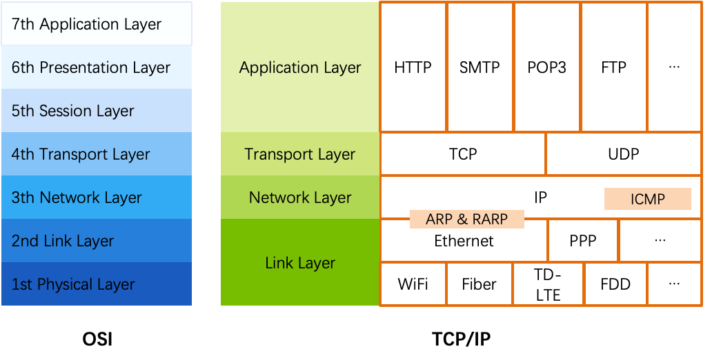
An overview of traditional networking
OSI
  The open systems interconnection (OSI) model
  7-layer architecture

Slide 61
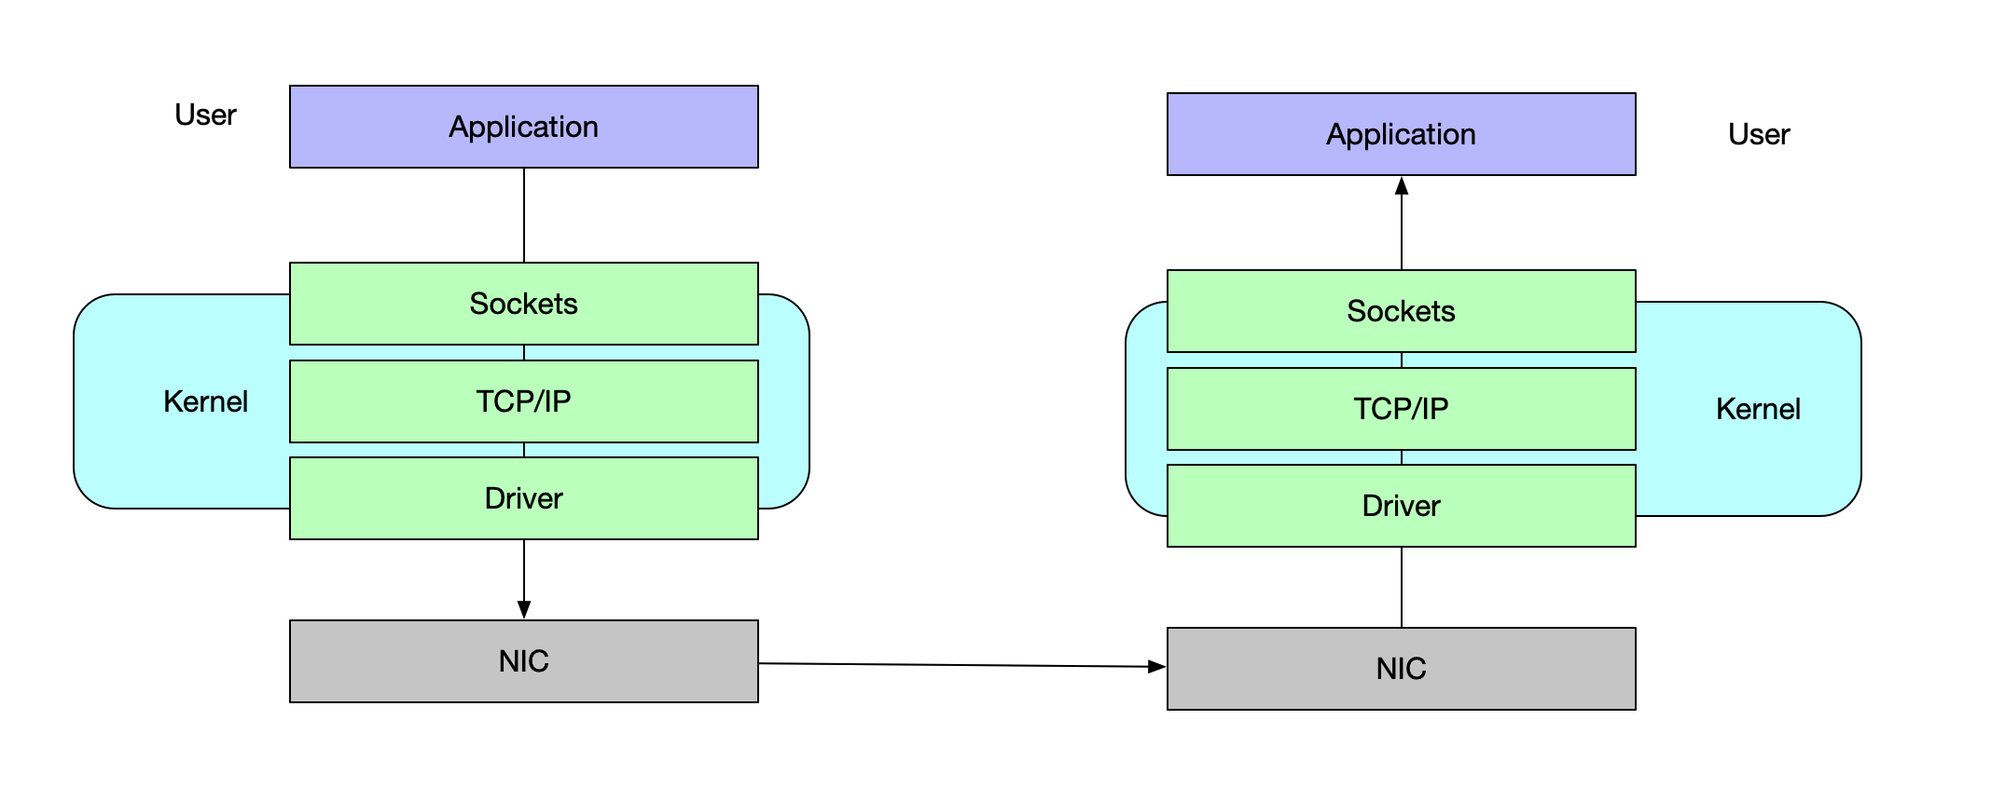
The OS implements the traditional network stack
CPU copy
CPU copy
Protocol
Processing
DMA copy
DMA copy

Slide 62
The OS implements the traditional network stack
Linux provides simple socket interfaces
  socket()
  bind()
  listen()
  connect()
  accept()
  read()
  write()
Can be a little complex if want high-performance
  epoll(), etc
Does the software interfaces
that simple as it seems?

Slide 63
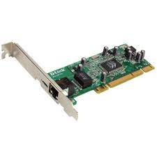

Packet processing in Linux
  Application
User space
  read(), write()
Kernel space
  Socket
  TCP/IP
  Driver
  Ring Buffer
Network card
  TX/RX queues

Slide 64
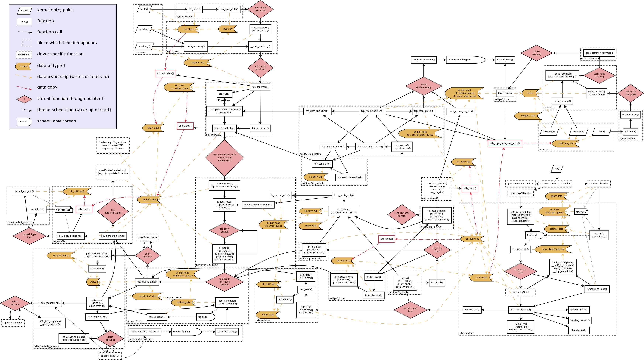
Linux networking software stack

Slide 65
What are the costs of such a complex networking stack?
Physical limit | ~1-10us
Linux/TCP/IP/stack | ~50-200us
Apps (e.g. KV) latency | ~8-100us
Notes:
包括call kernel的overhead和kernel-space 处理的开销

Slide 66
Maybe work for 10Gbps network
But what about 100Gbps?

Slide 67
What are the costs of such a complex networking stack?
Can we remove the
kernel overhead?
Physical limit | ~1-10us
Linux/TCP/IP/stack | ~50-200us
Apps (e.g. KV) latency | ~8-100us

Slide 68

Kernel-bypassing network
DPDK
  Set of user-space driver library to use the network card
DPDK directly exposes network queues to the user-space
  Forward network packets to/from NIC from/to user applications
    Without any kernel networking stack!
How to achieve so?
  OS will map the NIC’s TX (transmit queue) and RX (receive queue) to the user-land

Slide 69
Packet processing with DPDK
  Application
  DPDK
  Ring Buffer
User space
Kernel space
Network card
  TX/RX queues

Slide 70
Pros & Cons of DPDK
Pros
  Bypasses the kernel
  Reduced memcpy overhead
  User can customize the networking, e.g., not using TCP/IP
    E.g., co-design key-value store w/ DPDK (MICA@SIGCOMM’14)
Cons
  Not compatible to traditional networking
  Still need a transport layer at the user applications, e.g., mTCP
    Which has non-trivial overheads
Can we put the networking stack into the hardware?

Slide 71
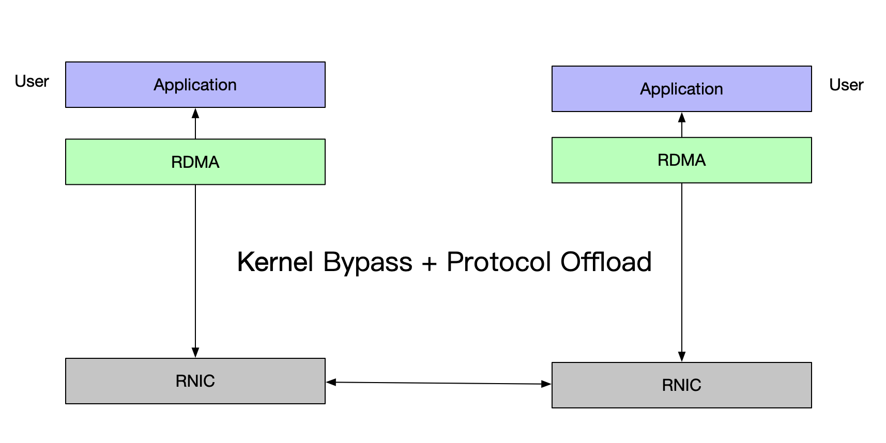
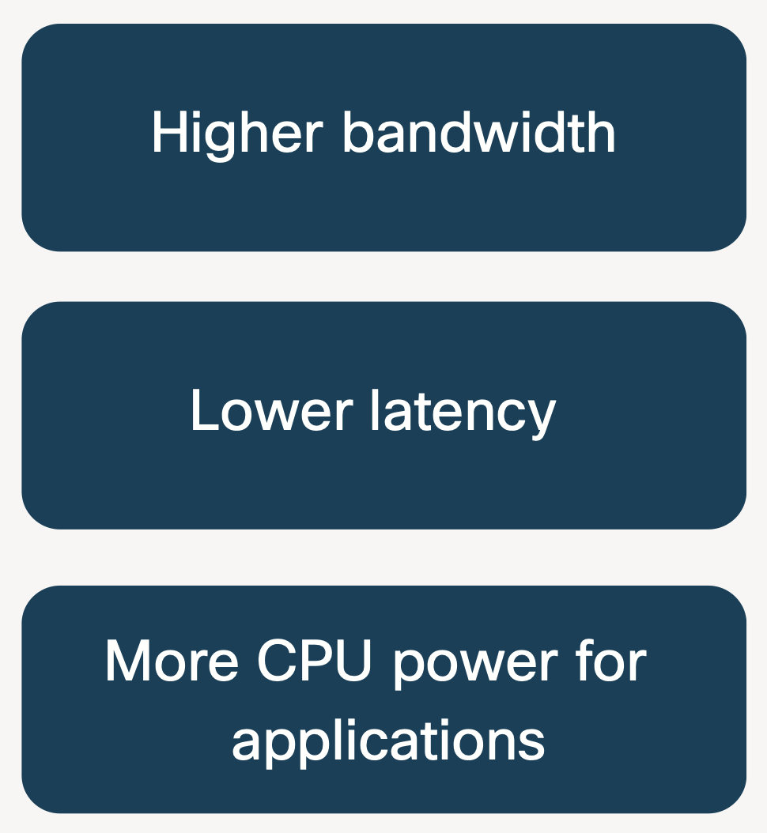
RDMA: offload the complete network stack to the NIC
RDMA = Remote Direct Memory Access
Direct memory-to-memory data communication over network.

Slide 72
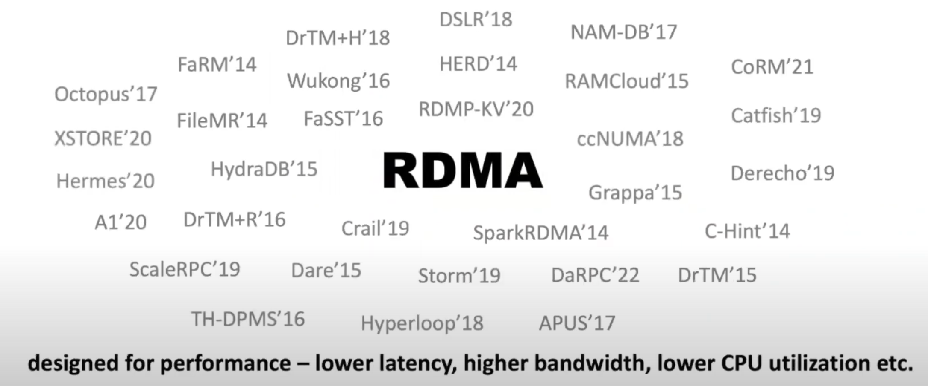
RDMA: offload the complete network stack to the NIC
RDMA is a Trending Topic in Cloud Systems.

Slide 73
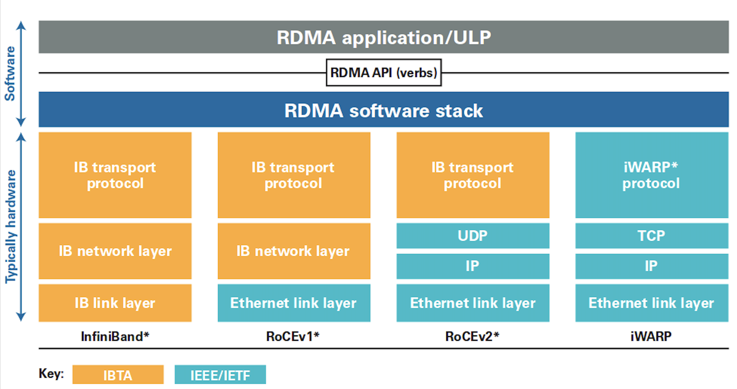
RDMA implementations: IB
Native infiniband (IB)
  Complete new protocol stack
  Best Performance
  Need specialized IB NIC and IB Switch (High Cost)

Slide 74
RDMA implementations: RoCE-v1
RDMA over Converged Ethernet Version 1
  Based on Ethernet in link layer.
    Compatible with the current network infrastructure.

Slide 75
RDMA implementations: RoCE-v2
RDMA over Converged Ethernet Version 1
  Carried by IP and UDP in network layer.
  More flexible & scalable than RoCE v1
  Most cloud datacenters choose RoCEv2 for large-scale deployments.

Slide 76
RDMA implementations: iWrap
An attempt to patch up on existing LAN/WAL network
  Layered on existing TCP/IP protocols
  In contrast, RoCE is a purpose-built RDMA transport protocol for Ethernet

Slide 77
Programming w/ RDMA (verbs)
The API is simplified for hardware offloading!
Notes:
https://ongardie.net/static/raft/userstudy/

Slide 78
High-level concepts of RDMA
Queue Pairs (Send Queue, Complete Queue and Receive Queue)
  SQ, CQ & RQ
  A group of queues form an RDMA connection
    Analog to connections in TCP/IP
User posts networking requests to the SQ
  Two-sided: message datagram (like send/recv)
  One-sided: remote read/write (will be talked about later)
Get the completion events of the send requests from the CQ
Receive two-sided messages from the RQ
Message buffers must be pre-allocated

Slide 79
Queue Pairs have different models
Reliable connected (RC)
  Like TCP/IP socket, provides reliable communications, supports all RDMA requests
Unreliable datagram (UD)
  Like UDP socket
  No reliability guarantees, limited RDMA requests type supported
Others
  Less commonly used
We focus on RC queue pair in this lecture

Slide 80
Reliable connection Queue Pairs (QP)s
Two QP must first establish a connection via handshake so as to proceed
  Similar to handshakes in TCP/IP
  We will talk about the connection establishment later
An reliable connection QP must be only connected to one other
Pair
Queue
pairs
Send
Comp
Recv
Queue
pairs
Send
Comp
Recv
RDMA

Slide 81
RDMA queue pair bring up
(Reliable connected) Queue pairs (QP) are connected before can be used
  Simplify reliable guarantees, etc.
  We call this bring up QP in this lecture
RDMA needs a handshake protocol to bring up two QPs
  Similar to TCP/IP handshake, but is not specified by the protocol
Pair
Queue
pairs
Send
Comp
Recv
Queue
pairs
Send
Comp
Recv
RDMA

Slide 82
First step: RDMA queue pair bring up
Needs to exchange a piece of connection data by the applications
  Not specified in the RDMA specification!!!
Users typically implements their own exchange method
  Typically, through another network: TCP/UDP, etc.
Network
Queue
pairs
RDMA

Slide 83
RDMA queue pair bring up
Requester creates its queue pairs
Network
Queue
pairs
Send
Comp
Recv
RDMA

Slide 84

RDMA queue pair bring up
Requester creates its queue pairs
Extract the queue pair information (via query_qp), send to the responder
Network
query_qp
Queue
pairs
Send
Comp
Recv
RDMA
Notes:
d

Slide 85
RDMA queue pair bring up
Requester creates its queue pairs
Extract the queue pair information (via query_qp), send to the responder
(Optional) Responder creates its queue pairs
  If it already has a created queue pair, can be ignored
Network
query_qp
Queue
pairs
Send
Comp
Recv
RDMA
Send
Comp
Recv
Notes:
d

Slide 86

RDMA queue pair bring up
Note that the hardware will do
all the connections in the modify QP
Requester creates its queue pairs
Extract the queue pair information, send to the responder
(Optional) Responder creates its queue pairs
Responder modify its queue pair to a connected state
ibv_modify_qp()...
Network
Queue
pairs
Send
Comp
Recv
RDMA
Send
Comp
Recv
Notes:
d

Slide 87
RDMA queue pair bring up
Extract the queue pair information, send to the requester
Network
query_qp
Queue
pairs
Send
Comp
Recv
RDMA
Send
Comp
Recv
Notes:
d

Slide 88
RDMA queue pair bring up
Extract the queue pair information, send to the requester
Requester modify its queue pair to a connected state with the received queue pair information
ibv_modify_qp()...
Network
Queue
pairs
Send
Comp
Recv
RDMA
Send
Comp
Recv
Notes:
d

Slide 89
RDMA queue pair bring up
Extract the queue pair information, send to the requester
Requester modify its queue pair to a connected state with the received queue pair information
Done!
  Both queue pairs can send/receive RDMA requests from the others
Pair
Queue
pairs
Send
Comp
Recv
Queue
pairs
Send
Comp
Recv
RDMA
Notes:
d

Slide 90


Next: send message with RDMA
“Hello”
Bob
RDMA
Alice
Queue
pairs
Send
Comp
Recv
Queue
pairs
Send
Comp
Recv

Slide 91
Register a message buffer to receive incoming message
“Hello”
ibv_post_recv
Bob
RDMA
Alice
Queue
pairs
Send
Comp
Recv
Queue
pairs
Send
Comp
Recv
Alice
struct ibv_sge list = { .addr = msg_buf, .length=5 };
struct ibv_recv_wr wr = {
.sg_list = &list,
..., // other fields
};
ibv_post_recv(alice_qp, &wr, ...); // post to the receive queue

Slide 92
Send the message with post_send
“Hello”
Bob
RDMA
Alice
Queue
pairs
Send
Comp
Recv
Queue
pairs
Send
Comp
Recv
bob
struct ibv_sge list = { .addr = (uintptr_t)"Hello", .length=5 };
struct ibv_send_wr wr = {
.sg_list = &list,
.op_code = IBV_WR_SEND // send a two-sided message
..., // other fields
};
ibv_post_send(bob_qp, &wr, ...); // send queue

Slide 93
Poll the completion of the send via polling
“Hello”
Bob
RDMA
Alice
Queue
pairs
Send
Comp
Recv
Queue
pairs
Send
Comp
Recv
bob
do {
num_completions = ibv_poll_cq(bob_com_qp, ...);
} while (num_completions == 0);
// The request has been successfully sent to the remote
// or an error happens

Slide 94
Poll the received message from Alice
“Hello”
Bob
RDMA
Alice
Queue
pairs
Send
Comp
Recv
Queue
pairs
Send
Comp
Recv
bob
do {
num_completions = ibv_poll_cq(alice_receive_qp, ...);
} while (num_completions == 0);
// The message must be stored in msg_buf if no error
Print(msg_buf) // Hello

Slide 95
Lifecycles of the sent message
Secrets behind RDMA: MMIO & DMA
  MMIO: Using LOAD and STORE
  DMA: Device directly read/write the memory (provided by PCIe)
Requester
Responder
CPU,RAM
NIC
NIC
RAM
CPU
1. Request descriptor, MMIO (post_send)
1
2. Payload, DMA read
2
3. Two-sided request
3
4
7
4. Payload, DMA write
5
5. RDMA ACK
6. Completion DMA write
(poll_cq)
6
7. Memory read to poll
the message
(poll_cq)
Credit: Anuj Kalia’s SIGCOMM talk
Notes:
问题： 6， 7谁先谁后？

Slide 96
RDMA vs. DPDK
Common
  Both are kernel bypassing
Advantage of RDMA
  Fully supported network in the hardware
  Fully zero copy
Advantage of DPDK
  More flexible, i.e., can use a customized network protocol
    RDMA’s black-boxed network protocol may result in poor performance if not using properly! (we will see)

Slide 97
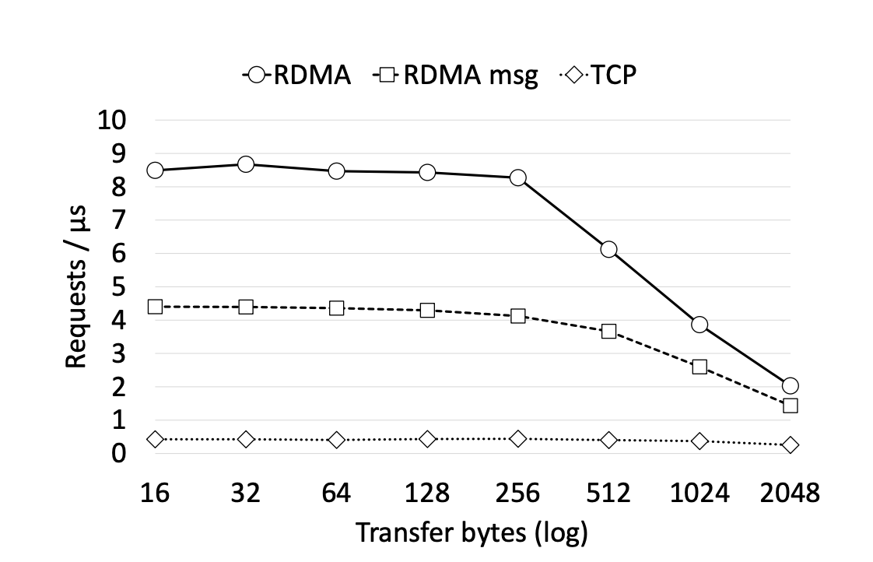
Performance of RDMA (message)
Source: Fast Remote Memory@NSDI’14

Slide 98
Is DPDK & RDMA (messaging) sufficient?

Slide 99
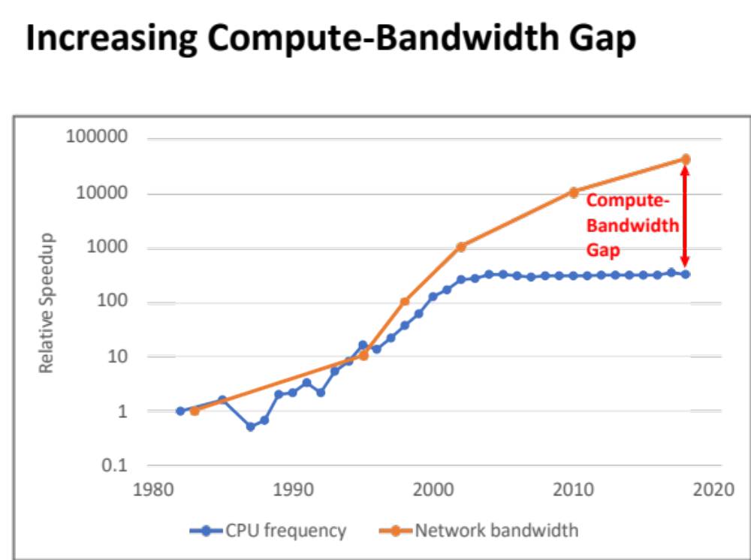
CPU is becoming the problem

Slide 100
CPU is the problem
CPU cannot become faster
  Power wall (e.g., dennard scaling), The decline of Moore's Law
NIC is continuously becoming faster
  Lower latency (down to 600ns)
  Higher bandwidth (up to 400Gbps)

Slide 101
Maybe we do not need such high bandwidth?
Most of the time the workload is idle
  Latency is more important than the bandwidth when the workload is idle
CPU achieves relatively low latency if idle w/ kernel-bypassing network
  No request queuing effect
  e.g., Two-sided RDMA achieves 2.2us RTT
  NIC RTT: ~1.5us

Slide 102
A hidden assumption of low-latency two-sided RDMA is using polling
Example: Bob uses polling to receive messages from the receive queue
  The while loop can easily burn the CPU!
bob
do {
num_completions = ibv_poll_cq(alice_receive_qp, ...);
} while (num_completions == 0);
// The message must be stored in msg_buf if no error
Print(msg_buf) // Hello
Problems of polling
  Extra CPU core usage (CPU cannot be used for others )
  Extra energy consumptions

Slide 103
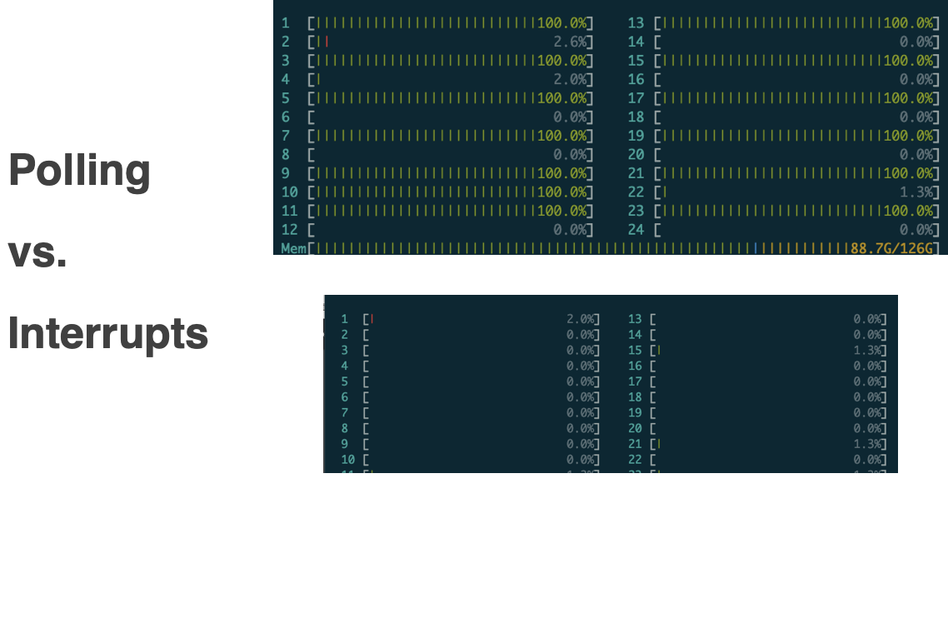
Can we use interrupt to reduce the energy?
Interrupt:
  Yield to the kernel, will be scheduled back once the message is received
  Energy efficient: CPU has nearly zero costs if no interrupt comes

Slide 104
Can we use interrupt to reduce the energy?
Interrupt:
  Yield to the kernel, will be scheduled back once the message is received
Problem:
  1000X latency increases! (2us vs. 2ms)
    Due to the kernel and scheduling effects of the CPU
Dilemma between energy & performance!

Slide 105
Does kernel-bypassing networking sufficient?
Not sufficient!

Slide 106

Efficiency = performance + low power consumption

Slide 107
We also need CPU bypassing!

Slide 108
High-level concepts of RDMA
Queue Pairs (Send Queue, Complete Queue and Receive Queue)
  SQ, CQ & RQ
  A group of queues form an RDMA connection
    Analog to connections in TCP/IP
User posts networking requests to the SQ
  Two-sided: message datagram (like send/recv)
  One-sided: remote read/write (in a CPU bypassing way!)
Get the completion events from the CQ
Receive two-sided messages from the RQ

Slide 109
One-sided RDMA
Observation:
  Remote read/write operations is common in applications
    We can let NIC do all these operations!

Slide 110
One-sided RDMA
Observation:
  Remote read/write operations is common in applications
    We can let NIC do all these operations!
One-sided RDMA
  READ
    The NIC can directly read the server memory bypassing server CPU
  WRITE
    The NIC can directly write the server memory bypassing server CPU
  ATOMICS (fetch & add, compare & swap)
    The NIC can directly execute atomic operations bypassing server CPU

Slide 111
Example: remote memory copy
Suppose we want to implement a remote procedure call (RPC) with RDMA
  The RPC will simply do a memory copy (memcpy)
  For simplicity, we assume only the requester copies to the responder
Bob
RDMA
Alice
Copy
DRAM
DRAM

Slide 112
Existing approach: two-sided RDMA based RPC
Requester
Responder
The message contains:
1. Remote address
2. Size of the payload
CPU,RAM
NIC
NIC
RAM
CPU
1. Request descriptor, MMIO
1
2. Payload, DMA read
2
3. Two-sided request
3
4
4. Payload, DMA write
5
8
5. RDMA ACK
6. Completion DMA write
6
7. Poll the two-sided request
9
8. Do the memory copy
10
10. Request descriptor, MMIO + payload DMA
11
11. Poll the two-sided request (reply), done

Slide 113
Remote memory copy with one-sided RDMA WRITE
One-sided
Request
Bob
RDMA
Queue
pairs
Send
Comp
Recv
struct ibv_sge list = { .addr = src, length=size };
struct ibv_send_wr wr = {
.sg_list = &list,
.op_code = IBV_WR_RDMA_WRITE, // to the the one-sided WRITE
.wr.wr.rdma.remote_addr = dst,
..., // other fields
};
ibv_post_send(bob_qp, &wr, ...); // send queue
bob

Slide 114
Remote memory copy with one-sided RDMA WRITE
Requester
Responder
CPU,RAM
NIC
NIC
RAM
1. Request descriptor, MMIO
1
2. Payload, DMA read
2
3. RDMA Write request
3
4
4. Payload, DMA write
5
6
5. RDMA ACK
6. Completion DMA write

Slide 115
One-sided RDMA WRITE vs. Two-sided RDMA
Notes:
性能

Slide 116
Question: how can RDMA access the remote memory?
RDMA can directly access the virtual address of the remote end
  How can the NIC find the DMA address?
  How can the remote end do the authentication?
    E.g., some virtual address cannot be exposed to the others
struct ibv_sge list = { .addr = src, length=size };
struct ibv_send_wr wr = {
.sg_list = &list,
.op_code = IBV_WR_RDMA_WRITE, // to the the one-sided WRITE
.wr.wr.rdma.remote_addr = dst,
..., // other fields
};
ibv_post_send(bob_qp, &wr, ...); // send queue

Slide 117
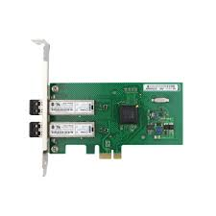
Memory registration (MR)
RDMA uses memory registrations to expose the virtual memory
If Alice wants to expose the memory, she must first register it to the RNIC
  Via ibv_reg_mr()
  Access flags: read/write,etc.
  Return: rkey
NIC will create an internal mapping
ibv_reg_mr(..., start, end– start, access_flags, ...)
Alice
Start
End
DRAM
Virtual – Physical mapping

Slide 118
One-sided RDMA with Memory Registration
One-sided
Request
Bob
RDMA
Queue
pairs
Send
Comp
Recv
bob
struct ibv_sge list = { .addr = src, length=size };
struct ibv_send_wr wr = {
.sg_list = &list,
.op_code = IBV_WR_RDMA_WRITE, // to the the one-sided WRITE
.wr.wr.rdma.remote_addr = dst,
.wr.wr.rdma.rkey = ...,
..., // other fields
};
ibv_post_send(bob_qp, &wr, ...); // send queue

Slide 119
One-sided RDMA with Memory Registration
Requester
Responder
CPU,RAM
NIC
NIC
RAM
1. Request descriptor, MMIO
1
4.1 Lookup the table
4.2 Check the rkey
4.3 Do the write
2. Payload, DMA read
2
3. RDMA Write request
3
4
4. Payload, DMA write
5
6
5. RDMA ACK
6. Completion DMA write

Slide 120
One-sided RDMA with Memory Registration
Requester
Responder
CPU,RAM
NIC
NIC
RAM
1. Request descriptor, MMIO
1
4.1 Lookup the table
4.2 Check the rkey
4.3 Do the write
2. Payload, DMA read
2
3. RDMA Write request
3
4
4. Payload, DMA write
5
6
5. RDMA ACK
6. Completion DMA write
Question: what about the local DMA?

Slide 121
Local RDMA access also needs MR
The same API ibv_reg_mr()
  Will return two keys: lkey & rkey
    Lkey is used for local accesses
    Rkey is used for remote accesses
bob
struct ibv_sge list = { .addr = src, length=size, lkey = lkey };
struct ibv_send_wr wr = {
.sg_list = &list,
.op_code = IBV_WR_RDMA_WRITE, // to the the one-sided WRITE
.wr.wr.rdma.remote_addr = dst,
.wr.wr.rdma.rkey = ...,
..., // other fields
};
ibv_post_send(bob_qp, &wr, ...); // send queue

Slide 122
Question: where is the mapping table stored?
Stored in DRAM
  Problem: NIC will use one DMA to fetch for the check (inefficient!)
NIC will uses a small SRAM for the cache
  Avoiding extra lookups for the MR
ibv_reg_mr(..., start, end– start, access_flags, ...)
Alice
End
DRAM
Virtual – Physical mapping

Slide 123
Performance summary of RDMA
We use one-sided RDMA WRITE as an example
  MMIO: 200-800ns (on Intel x864 machines)
  + (4) DMA: (about) 1us
  + (5): network, depends on the distance & speed of light
    << 1us in rack-scale clusters
  Memory access
    100-400ns
Total RTT: 2-5us
CPU,RAM
NIC
NIC
RAM
1. Request descriptor, MMIO
1
2. Payload, DMA read
2
3
4. Payload, DMA write
4
3. RDMA Write request
5
6
5. RDMA ACK
6. Completion DMA write

Slide 124
Short recap of RDMA
RDMA: a new networking protocol & API
  Extremely fast: 2-5us in a local rack-scale cluster
Kernel, Network protocol bypassing
  All RDMA operations
CPU-bypassing
  One-sided RDMA operations
    READ,WRITE and ATOMICS

